Slide 1
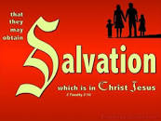
How to know if you are saved
By Karl Falken

Slide 2
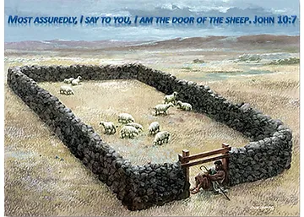
"I am the door. If anyone enters by me, he will be saved and will go in and out and find pasture." John 10:9 ESV
One of the most important questions we must answer in this life is, “Are we saved or lost?”

Slide 3
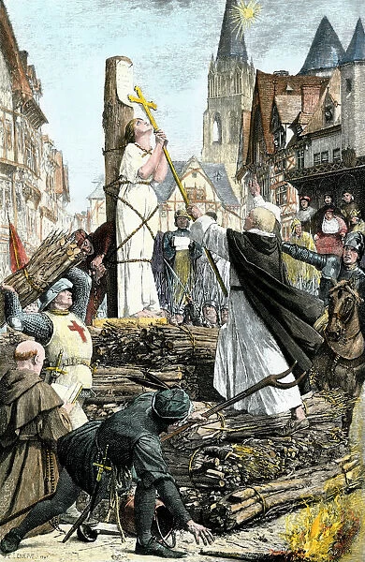
Joan of Arc
“If I am not (in grace), may God place me there; if I am, may God so keep me. I should be the saddest in all the world if I knew that I were not in the grace of God." When the English burned her at the stake, Joan of Arc died saying only one word over and over, “Jesus!”

Slide 4
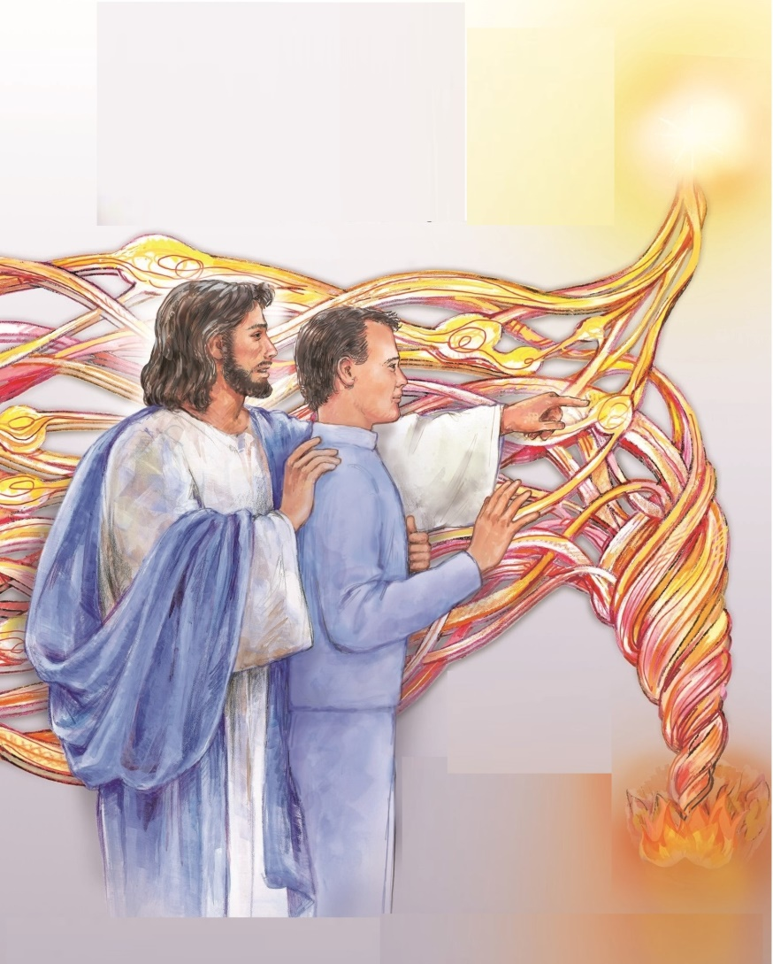
Currently, only 2.5% make it to heaven
In 1995 I had a Near Death Experience in which the Lord showed me the timeline of human history. When I realized that only 2.5% of the general population makes it to heaven, the Lord said to me, “ No one needs to go to hell. I paid the full price for them to be saved. I gave the church everything it needed to evangelize the world. The church could have won the whole world to Me in every generation.”
This number is verified by others:
Howard Pittman, “Placebo”, page 29
Dr. Kevin Zadai, 2022
Jeremy Nelson 2021, etc.

Slide 5
NECESSARY MAY NOT BE SUFFICIENT
A common mistake in logic is to confuse a Necessary with a Sufficient Condition.
It is a fallacy when a person assumes that a necessary condition for a result is sufficient for the result to occur.
A necessary condition is a condition that must be present for a result to be realized. However, there may be more than one necessary condition to create a sufficient condition. A sufficient condition is a condition or complete set of necessary conditions that will produce the result. A necessary condition must be there, but it alone does not provide sufficient cause for the realization of the result. Only the when the full set of conditions is sufficient, will the result be realized. In other words, all of the necessary elements must be there before the result is realized. That is to be saved, a person must meet all the criteria for salvation, not just some of them. It certainly is not enough for a person to feel they are saved.

Slide 6
CANON IV OF BIBLE INTEPRETATION
In Ivan Panin’s nine canons (rules) for Inter-preting scripture, Canon IV reads:
“A clear Statement in one part of the Bible is to be held to against others not so clear in other parts. The light from the clear to be thrown on the obscure, rather than the obscure to darken the light. A mere difficulty is not to annul a certainty.”

Slide 7

THE TEN CRITERIA FOR BEING SAVED
When all the obvious scriptures are studied together, ten criteria for salvation become apparent:
Belief in God (I Kings 8:33, Habakkuk 2:4, Luke 7:50, James 2:19)
Confession of sin (Leviticus 5:5, 26:40, James 5:16, I John 1:9)
Repentance of sin (II Chronicles 7:14, Acts 2:38, II Corinthians 7:10 James 2:17, 2:20, 21, 2:26)
Restitution for wrongs (Numbers 5:6, 7, Matthew 5:22-26)
Keeping the Lord’s commandments (Psalm 50:23, Isaiah 56:1), obeying His voice (Psalm 149:4)
Forgiving others (Mark 11:25, Matthew 6:14, 15, 18:35, Luke 6:37, 38, 11:3, 4,II Corinthians 2:10, Colossians 2:10, 11)
Declaring Jesus Christ as Savior (John 6:28, 29, 10:9, Acts 16:31, Romans 10:8-11)
Baptism by immersion in the name of the Father, Son and Holy Spirit, and calling on the Lord to be saved (Matthew 28:19, Mark 16:16, Acts 2:38, 22:16, Romans 6:4, 5, Colossians 2:11, 12, I Peter 3:21,22)
Taking communion (John 6:53-58)
Receiving the love of absolute spiritual truth . (II Thessalonians 2:9-19)
Enduring to the end (II Timothy 2:8-13), even to conquer the enemy (Matthew 24:9-13 , Revelation 3:5)
“The one who conquers will be clothed thus in white garments, and I will never blot his name out of the book of life. I will confess his name before my Father and before his angels.” Revelation 3:5 ESV

Slide 8

1. Belief in God
“When your people Israel are defeated before the enemy because they have sinned against you, and if they turn again to you and acknowledge your name and pray and plead with you in this house, then hear in heaven and forgive the sin of your people Israel and bring them again to the land that you gave to their fathers." I Kings 8:33, 34 ESV
“Behold, his soul is puffed up; it is not upright within him, but the righteous shall live by his faith.” Habakkuk 2:4 ESV
“And he said to the woman, ‘Your faith has saved you; go in peace.’” Luke 7:50 ESV
"You believe that God is one; you do well. Even the demons believe—and shudder!" James 2:19 ESV

Slide 9
2. Confession of Sin
“…when he realizes his guilt in any of these and confesses the sin he has committed,” Leviticus 5:5 ESV
“But if they confess their iniquity and the iniquity of their fathers in their treachery that they committed against me, and also in walking contrary to me, Leviticus 26:40 ESV
“Therefore, confess your sins to one another and pray for one another, that you may be healed. The prayer of a righteous person has great power as it is working. James 5:16 ESV
If we confess our sins, he is faithful and just to forgive us our sins and to cleanse us from all unrighteousness. I John 1:9

Slide 10
2. Repentance of Sin
“…if my people who are called by my name humble themselves, and pray and seek my face and turn from their wicked ways, then I will hear from heaven and will forgive their sin and heal their land.” II Chronicles 7:14 ESV
"And Peter said to them, “Repent and be baptized every one of you in the name of Jesus Christ for the forgiveness of your sins, and you will receive the gift of the Holy Spirit." Acts 2:38 ESV
"For godly grief produces a repentance that leads to salvation without regret, whereas worldly grief produces death." II Corinthians 7:10 ESV
"So also faith by itself, if it does not have works, is dead." James 2:17 ESV
"Do you want to be shown, you foolish person, that faith apart from works is useless? Was not Abraham our father justified by works when he offered up his son Isaac on the altar?" James 2:20, 21 ESV
"For as the body apart from the spirit is dead, so also faith apart from works is dead." James 2:26 ESV

Slide 11
3. Pay Debts, Taxes, Restitution for Wrongs
“Speak to the people of Israel, When a man or woman commits any of the sins that people commit by breaking faith with the LORD, and that person realizes his guilt, he shall confess his sin that he has committed. And he shall make full restitution for his wrong, adding a fifth to it and giving it to him to whom he did the wrong." Numbers 5:6, 7 ESV
"But I say to you that everyone who is angry with his brother will be liable to judgment; whoever insults his brother will be liable to the council; and whoever says, ‘You fool!’ will be liable to the hell of fire. So if you are offering your gift at the altar and there remember that your brother has something against you, leave your gift there before the altar and go. First be reconciled to your brother, and then come and offer your gift. Come to terms quickly with your accuser while you are going with him to court, lest your accuser hand you over to the judge, and the judge to the guard, and you be put in prison. Truly, I say to you, you will never get out until you have paid the last penny." Mat 5:22-26 ESV
“Pay to all what is owed to them: taxes to whom taxes are owed, revenue to whom revenue is owed, respect to whom respect is owed, honor to whom honor is owed. Fulfilling the Law Through Love. Owe no one anything, except to love each other, for the one who loves another has fulfilled the law.” Romans 13:7, 8 ESV

Slide 12
4. Restitution for wrongs
“Speak to the people of Israel, When a man or woman commits any of the sins that people commit by breaking faith with the LORD, and that person realizes his guilt, he shall confess his sin that he has committed. And he shall make full restitution for his wrong, adding a fifth to it and giving it to him to whom he did the wrong." Numbers 5:6,7 ESV
"But I say to you that everyone who is angry with his brother will be liable to judgment; whoever insults his brother will be liable to the council; and whoever says, ‘You fool!’ will be liable to the hell of fire. So if you are offering your gift at the altar and there remember that your brother has something against you, leave your gift there before the altar and go. First be reconciled to your brother, and then come and offer your gift. Come to terms quickly with your accuser while you are going with him to court, lest your accuser hand you over to the judge, and the judge to the guard, and you be put in prison. Truly, I say to you, you will never get out until you have paid the last penny." Matthew 5:22-26 ESV

Slide 13
5. Keeping the Lord’s Commandments
"The one who offers thanksgiving as his sacrifice glorifies me; to one who orders his way rightly I will show the salvation of God!” Psalm 50:23 ESV
“Thus says the LORD: “Keep justice, and do righteousness, for soon my salvation will come, and my righteousness be revealed.” Isaiah 56:1 ESV
“For the LORD takes pleasure in his people; He adorns the humble (obedient) with salvation.” Psalm 149:4 ESV

Slide 14
6. Forgiving Others
“And whenever you stand praying, forgive, if you have anything against anyone, so that your Father also who is in heaven may forgive you your trespasses.” Mark 11:25
"For if you forgive others their trespasses, your heavenly Father will also forgive you, but if you do not forgive others their trespasses, neither will your Father forgive your trespasses." Matthew 6:14, 15 ESV
"So also my heavenly Father will do to every one of you, if you do not forgive your brother from your heart.” Matthew 18:35 ESV
“Judge not, and you will not be judged; condemn not, and you will not be condemned; forgive, and you will be forgiven; give, and it will be given to you. Good measure, pressed down, shaken together, running over, will be put into your lap. For with the measure you use it will be measured back to you.” Luke 6:37, 38 ESV
“Give us each day our daily bread, and forgive us our sins, for we ourselves forgive everyone who is indebted to us. And lead us not into temptation. ” Luke 11:3 ,4 ESV
“Anyone whom you forgive, I also forgive. Indeed, what I have forgiven, if I have forgiven anything, has been for your sake in the presence of Christ, so that we would not be outwitted by Satan; for we are not ignorant of his designs.” II Corinthians 2:10 , 11 ESV
"Put on then, as God's chosen ones, holy and beloved, compassionate hearts, kindness, humility, meekness, and patience, bearing with one another and, if one has a complaint against another, forgiving each other; as the Lord has forgiven you, so you also must forgive." Colossians 3:12, 13 ESV

Slide 15
7. Declare Jesus Christ as Savior and Lord
"But what does it say? 'The word is near you, in your mouth and in your heart' [Deuteronomy 30:12-14]. (that is, the word of faith that we proclaim); because, if you confess with your mouth that Jesus is Lord and believe in your heart that God raised him from the dead, you will be saved. For with the heart one believes and is justified, and with the mouth one confesses and is saved. For the Scripture says, 'Everyone who believes in him will not be put to shame.'[Isaiah 28:16]” Romans 10:8-11 ESV
"Then they said to Him, What may we do that we may work the works of God? Jesus answered and said to them, ‘This is the work of God, that you believe into Him whom that One sent.’" John 6:28, 29 ESV
“I am the door. If anyone enters by me, he will be saved and will go in and out and find pasture.” John 10:9 ESV
“And they said, ‘Believe in the Lord Jesus, and you will be saved, you and your household.’” Acts 16:31 ESV

Slide 16
8. Baptism by immersion in the name of the Father, Son & Holy Spirit, & calling on the Lord to be saved
"Go therefore and make disciples of all nations, baptizing them in the name of the Father and of the Son and of the Holy Spirit, teaching them to observe all that I have commanded you. And behold, I am with you always, to the end of the age.” Matthew 28:19, 20 ESV
“Whoever believes and is baptized will be saved, but whoever does not believe will be condemned.” Mark 16:16 ESV
“And Peter said to them, “Repent and be baptized every one of you in the name of Jesus Christ for the forgiveness of your sins, and you will receive the gift of the Holy Spirit.” Acts 2:38 ESV
“And now why do you wait? Rise and be baptized and wash away your sins, calling on his name.” Acts 22:16 ESV
"We were buried therefore with him by baptism into death, in order that, just as Christ was raised from the dead by the glory of the Father, we too might walk in newness of life. For if we have been united with him in a death like his, we shall certainly be united with him in a resurrection like his." Romans 6:4, 5 ESV
“In him also you were circumcised with a circumcision made without hands, by putting off the body of the flesh, by the circumcision of Christ, having been buried with him in baptism, in which you were also raised with him through faith in the powerful working of God, who raised him from the dead.” Colossians 2:11, 12 ESV
“Baptism, which corresponds to this, now saves you, not as a removal of dirt from the body but as an appeal to God for a good conscience, through the resurrection of Jesus Christ, who has gone into heaven and is at the right hand of God, with angels, authorities, and powers having been subjected to him.” I Peter 3:21, 22 ESV

Slide 17
9. Taking Communion/The Lord’s Supper
"So Jesus said to them, 'Truly, truly, I say to you, unless you eat the flesh of the Son of Man and drink his blood, you have no life in you. Whoever feeds on my flesh and drinks my blood has eternal life, and I will raise him up on the last day. For my flesh is true food, and my blood is true drink. Whoever feeds on my flesh and drinks my blood abides in me, and I in him. As the living Father sent me, and I live because of the Father, so whoever feeds on me, he also will live because of me. This is the bread that came down from heaven, not like the bread the fathers ate, and died. Whoever feeds on this bread will live forever.” John 6:53-58 ESV

Slide 18
10. Receiving the love of absolute spiritual truth .
His coming is according to the working of Satan in all power and miraculous signs and lying wonders, and in all deceit of unrighteousness in those being lost, because they did not receive the love of the truth in order for them to be saved.”
II Thessalonians 2:9, 10 LITV

Slide 19
11a. Enduring to the end,
11 b. Even to conquer the enemy
"Remember Jesus Christ, risen from the dead, the offspring of David, as preached in my gospel, for which I am suffering, bound with chains as a criminal. But the word of God is not bound! Therefore I endure everything for the sake of the elect, that they also may obtain the salvation that is in Christ Jesus with eternal glory. The saying is trustworthy, for: If we have died with him, we will also live with him; if we endure, we will also reign with him; if we deny him, he also will deny us; if we are faithless, he remains faithful— for he cannot deny himself." II Timothy 2:8-13 ESV
“Then they will deliver you up to tribulation and put you to death, and you will be hated by all nations for my name's sake. And then many will fall away and betray one another and hate one another. And many false prophets will arise and lead many astray. And because lawlessness will be increased, the love of many will grow cold. But the one who endures to the end will be saved.“ Matthew 24:9-13 ESV
“The one who conquers will be clothed thus in white garments, and I will never blot his name out of the book of life. I will confess his name before my Father and before his angels.” Revelation 3:5 ESV

Slide 20

We Must Partner With the Lord
Just as the Israelites could not keep the Royal Law without the supernatural intervention of the Lord, so Christian believers cannot please the Lord without having Him dwell in their hearts and by walking in the Holy Spirit.

Slide 21
RECEIVING THE LORD INTO YOUR HEART
“Behold, I stand at the door and knock. If anyone hears my voice and opens the door, I will come in to him and eat with him, and he with me.” Revelation 3:20 ESV
"'Yet a little while and the world will see me no more, but you will see me. Because I live, you also will live. In that day you will know that I am in my Father, and you in me, and I in you. Whoever has my commandments and keeps them, he it is who loves me. And he who loves me will be loved by my Father, and I will love him and manifest myself to him.' Judas (not Iscariot) said to him, 'Lord, how is it that you will manifest yourself to us, and not to the world?' Jesus answered him, 'If anyone loves me, he will keep my word, and my Father will love him, and we will come to him and make our home with him.'" John 14:19-23 ESV

Slide 22
Walk in the Spirit to Overcome Temptation
“But I say, walk by the Spirit, and you will not gratify the desires of the flesh. For the desires of the flesh are against the Spirit, and the desires of the Spirit are against the flesh, for these are opposed to each other, to keep you from doing the things you want to do. But if you are led by the Spirit, you are not under the law.” Galatians 5:16-18 ESV
“If we live by the Spirit, let us also keep in step with the Spirit.” Gal 5:25 ESV

Slide 23
Heresy No. 1 - OSAS
No. 1 Heresy - “Once saved always saved” heresy. This erroneously claims that once a person has met the criteria for salvation, they cannot lose it, no matter what you think, say or do. Criteria no. 10 answers this right away. Matthew records the words of Christ saying to be saved we must endure to the end. John even records Christ saying a person must conquer to receive a white robe and not be blotted out from the book of life! A person could meet the first nine criteria at one point in life and yet deny Christ at a latter point. It is very likely that such a person loses their salvation. For Christ said He will deny such a person before the Father and they are blotted out of the book of life.
“So everyone who acknowledges me before men, I also will acknowledge before my Father who is in heaven, but whoever denies me before men, I also will deny before my Father who is in heaven.” Matthew 10:32, 33 ESV
It doesn’t add a clause where “If they acknowledged Me first, they can deny Me later without consequence.” Actually, the latter case fallows the former, not vice versa.
Persecuting the righteous also brings condemnation. In Psalm 69, David wrote of the fate of those who persecute the righteous:
“Add to them punishment upon punishment; may they have no acquittal from you. Let them be blotted out of the book of the living; let them not be enrolled among the righteous. Psalm 69:27, 28 ESV

Slide 24
Heresy No. 2–A Sinner’s Prayer Is Enough
The story of the crucified thief that repented is cited in support of this.
“Two others, who were criminals, were led away to be put to death with him. And when they came to the place that is called The Skull, there they crucified him, and the criminals, one on his right and one on his left. And Jesus said, ‘Father, forgive them, for they know not what they do.’ And they cast lots to divide his garments.
And the people stood by, watching, but the rulers scoffed at him, saying, ‘He saved others; let him save himself, if he is the Christ of God, his Chosen One!’
The soldiers also mocked him, coming up and offering him sour wine and saying, ‘If you are the King of the Jews, save yourself!’
There was also an inscription over him, ‘This is the King of the Jews.’
One of the criminals who were hanged railed at him, saying, ‘Are you not the Christ? Save yourself and us!’
But the other rebuked him, saying, ‘Do you not fear God, since you are under the same sentence of condemnation? And we indeed justly, for we are receiving the due reward of our deeds; but this man has done nothing wrong.’ And he said, ‘Jesus, remember me when you come into your kingdom.’ And he said to him, ‘Truly, I say to you, today you will be with me in paradise.’” Luke 23:32-43 ESV
Of the ten criteria listed above, the thief only met 1, 2, 3, 7, & 10. Christ still assured the thief that he would see paradise. From this some reason that just acknowledging Christ as “Lord” is enough. Yet the Scriptures do not tell us any previous history of the thief. He might have been a backslidden disciple. Canon IV implies tells us that more background information is needed to draw that conclusion.

Slide 25
THE UNFORGIVABLE SIN
A PERSON MAY ALSO COMMIT THE UNFORGIVABLE SIN AND LOSE THEIR SALVATION
“Therefore I tell you, every sin and blasphemy will be forgiven people, but the blasphemy against the Spirit will not be forgiven. And whoever speaks a word against the Son of Man will be forgiven, but whoever speaks against the Holy Spirit will not be forgiven, either in this age or in the age to come.” Matthew 12:31, 32 ESV
This explains how Peter’s salvation was both lost and restored. Blasphemy, in this case even an extremely severe form of it: denying Christ, is forgivable. Peter did not deny Holy Spirit, which is unforgivable. Judas also denied the Lord by betraying Him. However, while Judas also felt remorse, he made no effort to reconcile; but hanged himself.
This is why there is little hope for those in cults like the Watchtower Society which has an official, openly published and widely taught doctrine denying that Holy Spirit is a person in the Godhead. In fact, they very incorrectly deny that He is a person at all! Those who deny the power and gifts of the Holy Spirit are also in grave danger because these are signs, evidence, of His divinely appointed role in the body of Christ.

Slide 26
EVIDENCE OF SALVATION – PART 1
The last words of Jesus recorded by Mark are “And these signs will accompany those who believe: in my name they will cast out demons; they will speak in new tongues; they will pick up serpents with their hands; and if they drink any deadly poison, it will not hurt them; they will lay their hands on the sick, and they will recover.” Mark 16:17, 18 ESV
Here are five supernatural signs that a person is saved: In the Name of Jesus Christ they will:
cast out demons
speak in new tongues (a spiritual language), glossolalia
handle venomous snakes without suffering harm
ingest toxic substances without harm
heal the sick by the laying on of hands.
Tongues as an Actual Foreign Language. The first type of tongues we observe took place in the book of Acts, on the day of Pentecost. ...
Tongues as a Prayer Language. Praying in tongues carries a different function of this gift. ...
Tongues as a Form of Praise. ...
Tongues with Interpretation.

Slide 27
EVIDENCE OF SALVATION – PART 2
Another evidence that a person is saved is that they are consistently in unity with other believers, boldly promoting the gospel and not afraid of the opposition.
“Only let your manner of life be worthy of the gospel of Christ, so that whether I come and see you or am absent, I may hear of you that you are standing firm in one spirit, with one mind striving side by side for the faith of the gospel, and not frightened in anything by your opponents. This is a clear sign to them of their destruction, but of your salvation, and that from God.” Philippians 1:27, 28 ESV

Slide 28
EVIDENCE OF SALVATION – PART 3
I Samuel 2:1 implies that the redeemed will rejoice (Habakkuk 3:18, Zechariah 9:9) in their salvation by (Psalm 40:16 & Psalm 70:4) saying “Great is the LORD!”
I Chronicles 16:23 implies that the redeemed will broadly tell others about their salvation.
Psalms 9:14 & 118:15 imply that the redeemed will praise the Lord.
Psalm 18:46 implies that the redeemed will bless and exalt the Lord.
Psalm 20:5 implies that the redeemed will shout for joy about their salvation.
Psalm 21:1 & Psalm 35:9 implies that the redeemed will exult in their salvation.
Psalm 51:14 implies the redeemed will sing of the righteousness of the Lord.
Psalm 62:2 & 6 implies that the redeemed will be confident that they are saved.
Matthew 16:24 implies that the redeemed will live a sanctified life, denying themselves and living for Christ.
II Timothy 3:15 & I Peter 1:10 imply that the redeemed will become wise through studying the scriptures.

Slide 29
WHO IS SALVATION FOR?
Salvation is for the nation of Israel first, but also for the gentiles.
“For I am not ashamed of the gospel, for it is the power of God for salvation to everyone who believes, to the Jew first and also to the Greek.” Romans 1:16 ESV
“Therefore let it be known to you that this salvation of God has been sent to the Gentiles; they will listen.” Acts 28:28 ESV

Slide 30
GENDER MAKES A DIFFERENCE!
The Apostle Paul wrote, “Let a woman learn quietly with all submissiveness. I do not permit a woman to teach or to exercise authority over a man; rather, she is to remain quiet. For Adam was formed first, then Eve; and Adam was not deceived, but the woman was deceived and became a transgressor. Yet she will be saved through childbearing—if they continue in faith and love and holiness, with self-control.” I Timothy 2:11-15 ESV
That is, if a married, fertile woman refuses to bear children, she may compromise her salvation. If she aborts her own child or helps or encourages another woman to have an abortion, she may lose her salvation if she does not repent! This is because the Lord commanded Adam and Eve (and their descendants) to multiply (Genesis 1:28). This command was renewed to Noah and his family (Genesis 9:1). Those are commandments of the Lord and they have not been revised since then.
A Christian woman must also demonstrate self-control with three qualities in her character:
faith
love
Holiness
A woman who professes Christ as Savior and Lord, yet lacks self-control and practices unbelief, selfishness and sin is surely lost.

Slide 31
SALVATION IS NOT AVAILABLE FROM ANOTHER SOURCE
“But I with the voice of thanksgiving will sacrifice to you; what I have vowed I will pay. Salvation belongs to the LORD!” Jonah 2:9 ESV
“And there is salvation in no one else, for there is no other name under heaven given among men by which we must be saved.” Acts 4:12 ESV

Slide 32
SALVATION IS ETERNAL
“Lift up your eyes to the heavens, and look at the earth beneath; for the heavens vanish like smoke, the earth will wear out like a garment, and they who dwell in it will die in like manner; but my salvation will be forever, and my righteousness will never be dismayed.” Isaiah 51:6 ESV
“All that the Father gives me will come to me, and whoever comes to me I will never cast out.” John 6:37 ESV

Slide 33
WHY ARE WE SAVED?
It’s really not about us, but for the glory and praise of the Lord.
“I bring near my righteousness; it is not far off, and my salvation will not delay; I will put salvation in Zion, for Israel my glory.” Isaiah 46:13 ESV
"Blessed be the God and Father of our Lord Jesus Christ, who has blessed us in Christ with every spiritual blessing in the heavenly places, even as he chose us in him before the foundation of the world, that we should be holy and blameless before him. In love he predestined us for adoption to himself as sons through Jesus Christ, according to the purpose of his will, to the praise of his glorious grace, with which he has blessed us in the Beloved." Ephesians 1:3-6 ESV

Slide 34
CONCLUSION: SALVATION IS NOT AUTOMATIC
Anyone can be saved, but it is not automatic. People believe because the gospel is preached to them.
“For the Scripture says, ‘Everyone who believes in him will not be put to shame.’ For there is no distinction between Jew and Greek; for the same Lord is Lord of all, bestowing his riches on all who call on him. For ‘everyone who calls on the name of the Lord will be saved.’ How then will they call on him in whom they have not believed? And how are they to believe in him of whom they have never heard? And how are they to hear without someone preaching? And how are they to preach unless they are sent? As it is written, ‘How beautiful are the feet of those who preach the good news!’ But they have not all obeyed the gospel. For Isaiah says, ‘Lord, who has believed what he has heard from us?’ So faith comes from hearing, and hearing through the word of Christ. But I ask, have they not heard? Indeed they have, for ‘Their voice has gone out to all the earth, and their words to the ends of the world.” Romans 10:11 ESV
Notice pattern here:
A preacher is sent to preach the gospel
The gospel is preached and people hear it
The hearers believe, call on the Lord and are saved
The process is two way though. They believe and come to Jesus because God the Father calls them and they are drawn to the Son.

Slide 35
Conclusion: Salvation Can Be Inherited!
Only 16% of those not raised in church attend church as adults. Only 1/3 of those raised as an adolescent in an evangelical Christian home are still attending church in their twenties. Only about 1/3 leave the church as adults when both parents actively teach the faith to them. About 90% of children of parents actively engaged in witnessing stay in the church as adults.

Slide 36
Question? Comments?
“And He (Jesus Christ) said to them, ‘Go into all the world and proclaim the gospel to the whole creation.’” Mark 16:15 ESV

